Slide 1
React and Redux: Lesson 1 Introduction, theory and your first react component
William Abboud
* Covers React v15 - 16
Notes:
Welcomings
What this course will cover
How deep we will go into React and Redux
What versions will we cover
Talk about homework, exams and additional materials
How to contact me ?

Slide 2
Who is this course for ?
People comfortable with JavaScript
People with excellent knowledge of HTML
People who want to learn the two hottest JS libraries out there these days
Notes:
Speak about who this course is for and who would benefit from it.

Slide 3

React
Notes:
Course starts to explore react first and how it fits in modern JavaScript driven websites
Website and web app what’s the difference and where does React fit ?
Brief history of React and talk about the community
Talk about what its like to have worked with React for the past 2 years
Talk how hard React is and how to make your life easier

Slide 4
Just what the hell is React ?
React is a JavaScript library which makes it easy to break down website/webapp’s UI into easy to use units called “Components”.
Notes:
Talk about the Component pattern
Talk about the way UI has been done so far
Talk about how React tries to do it differently

Slide 5
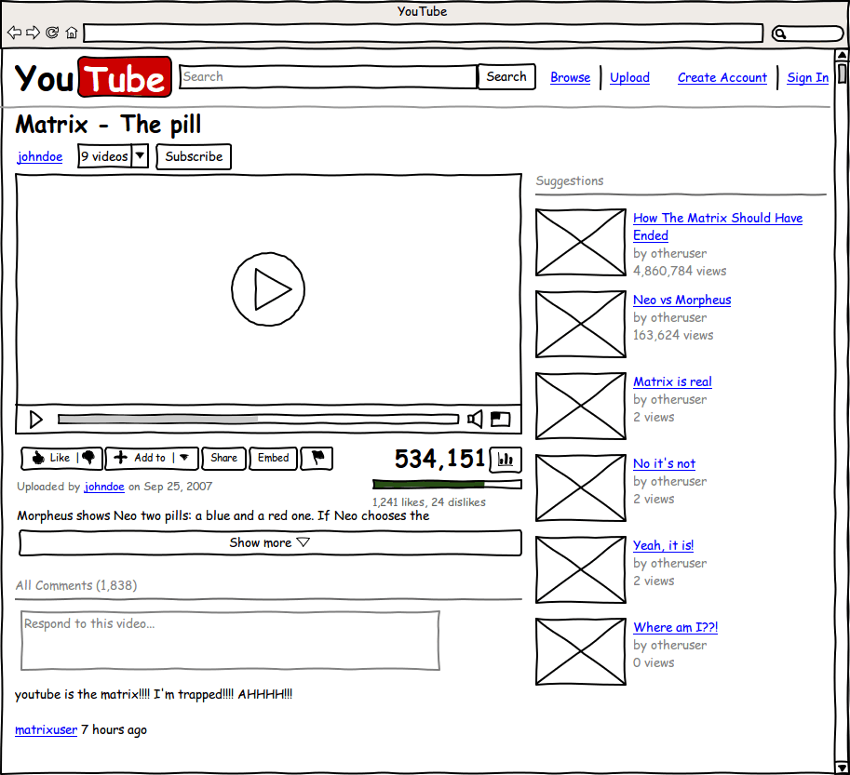
Components
Notes:
Talk about the similarities between wireframes and components

Slide 6
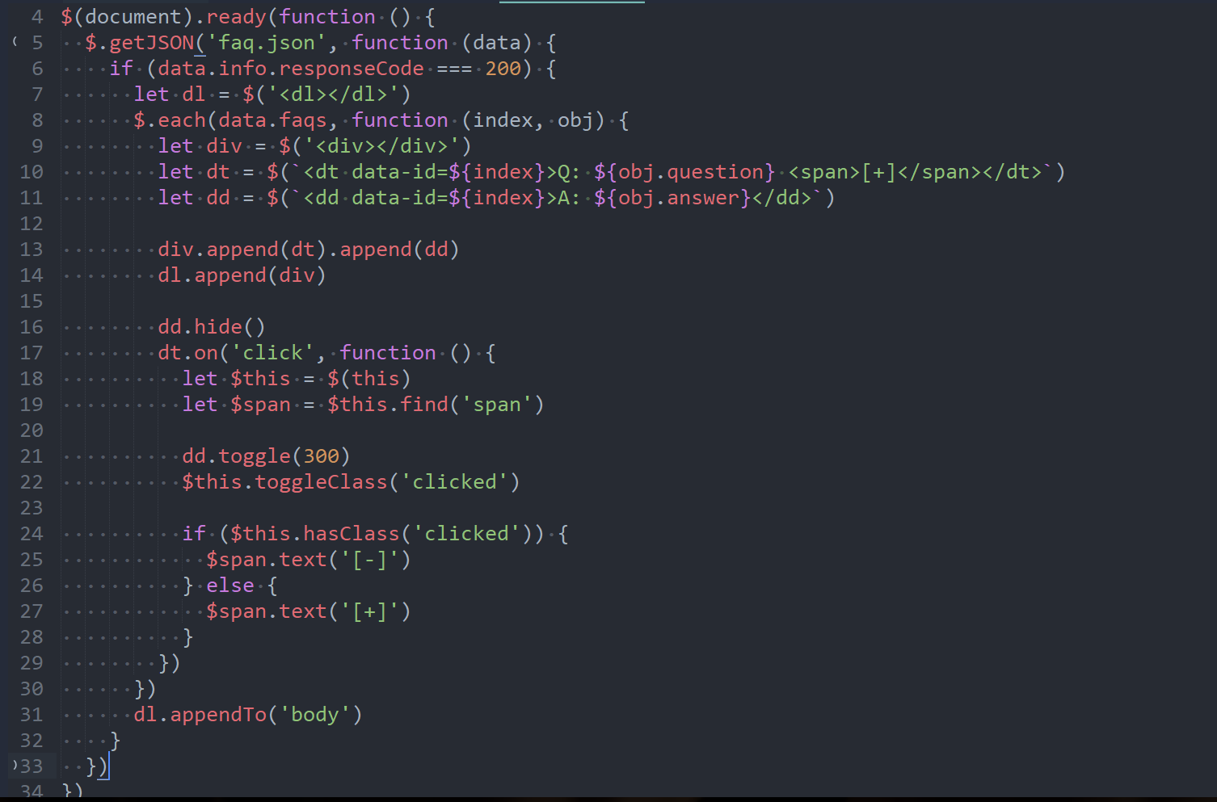
The World without React
Notes:
jQuery components - what they are, problems and what React aimed to fix
Other approaches such as Templates and their downsides

Slide 7
D0 we need React ?
The short answer imo is - No !
You don’t need React to create websites these days or any other framework or library for that matter.
However, React makes it really easy to create single responsibility UI units (Components) by giving you the necessary tools to create them in a way that follows the principles of single responsibility, low coupling, encapsulation and composition to the dot.
Note: (If you use it correctly)
Notes:
That’s just my opinion.
React is just a tool like any other and it’s only as good as its user
Here’s an example of a JS component in Jquery that follows the principles of breaking down things in Components

Slide 8
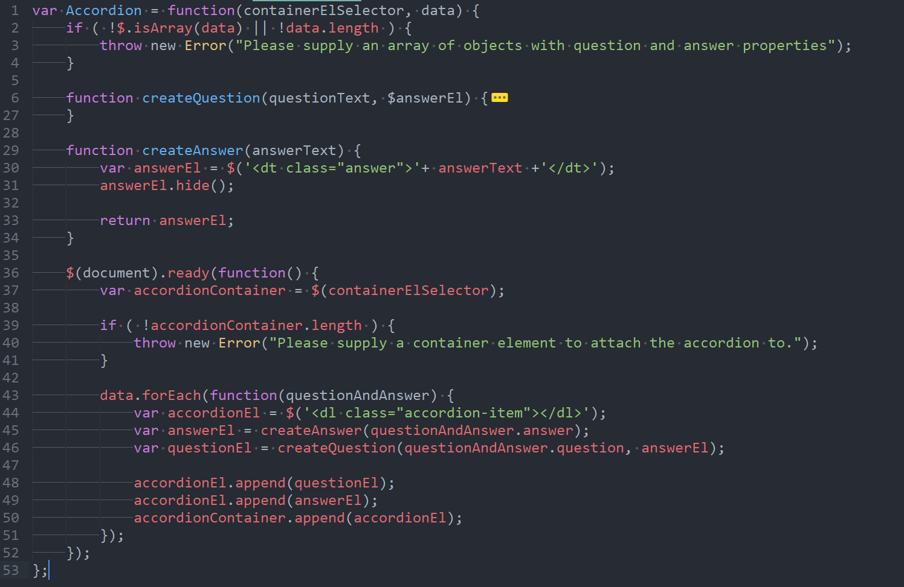
Notes:
Problem #1 - Directly manipulating the DOM - why is that bad ?
Problem #2 - Lack of control
Problem #3 - Lack of state
Problem #4 - Lack of type checking
Problem #5 - Syntax noise
Problem #5 - Imperative approach

Slide 9

Tools of the trade
Photo by Kelvyn Ornettte Sol Marte on Unsplash
Notes:
Start talking about what tools are we going to need and how they will make our lives easier
Using tools incrementally and understanding why we need them

Slide 10



NodeJS 8.x.x and above
Babel - to transpile JSX, ES6 JavaScript to ES5*, sourcemaps and more
Webpack
ESLint
Jest
React Create App
* Technically there are browsers out there that fully support ES6 now days - https://kangax.github.io/compat-table/es6/
Notes:
Give a brief overview of each tool that we will use
Why we use React Create App

Slide 11

Let’s get into the code !
Photo by Temple Cerulean on Unsplash
Notes:
Show the most basic react component
Explain react createElement function and why you won’t see it with JSX
Create barebones profile card
Explain how React creates an abstraction above HTML elements composed of HTML elements

Slide 12
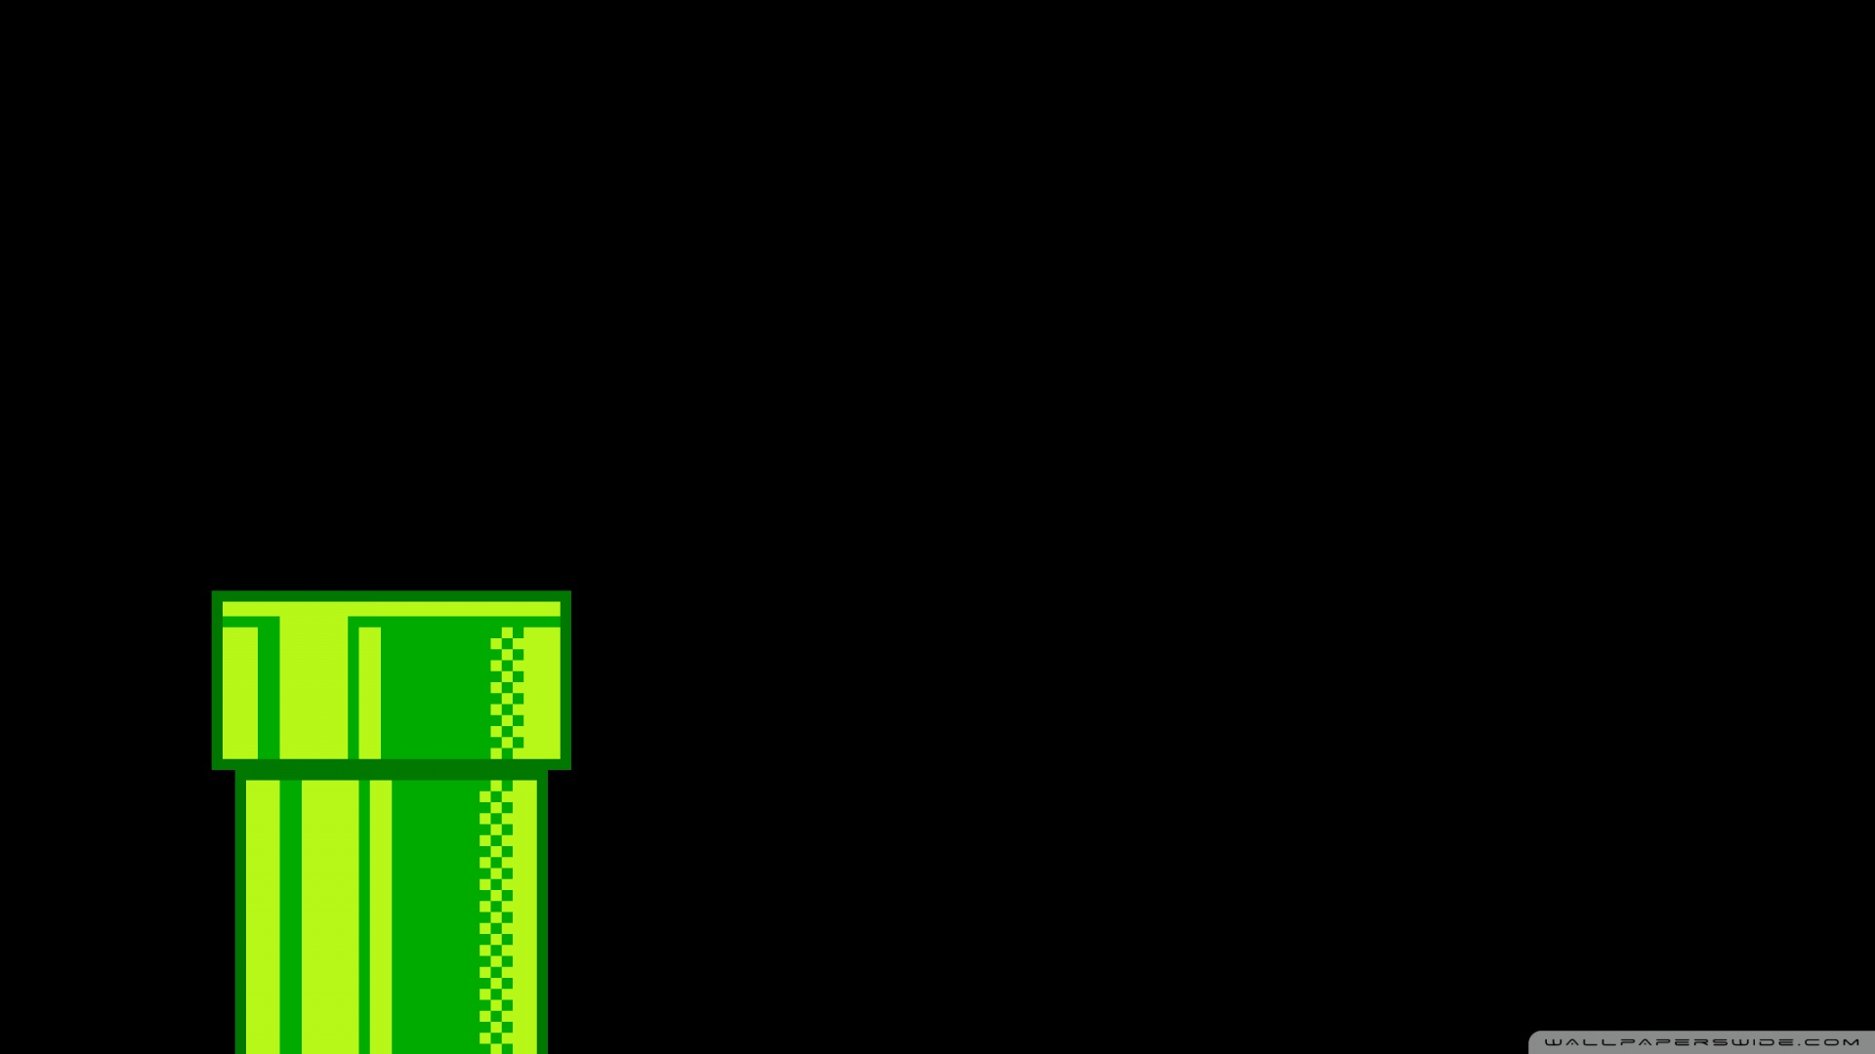
One way Data Flow and props
Notes:
Talk about how React components are like custom HTML tags
React borrows principles from HTML
Talk about how props are like attributes and how you can pass native HTML attributes and custom ones
Talk about what One way data flow is, and how props are read only to keep react render function pure
Show a themable component with a white and dark theme

Slide 13
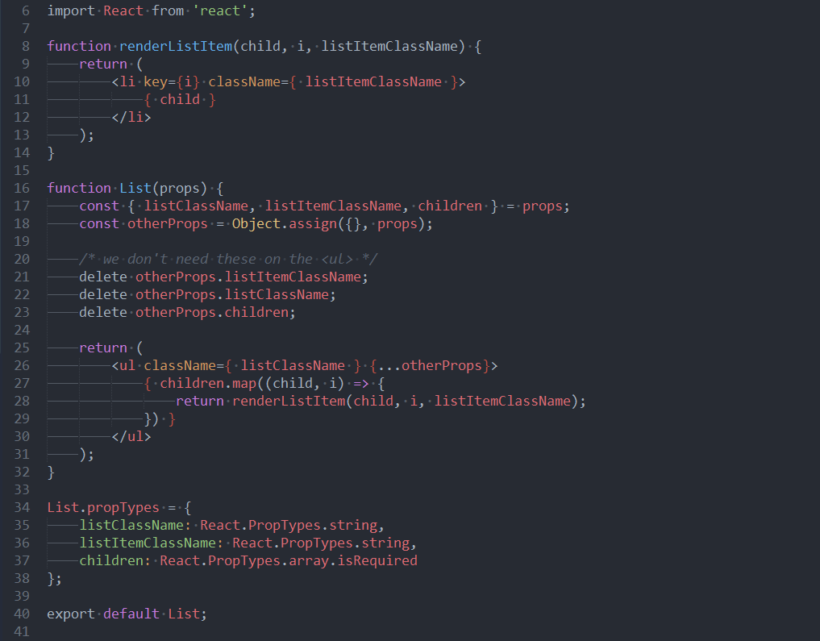
Sample React Component
Notes:
Give a brief overview of what is on the screen and intro to JSX

Slide 14

… Continued

